Slide 1

IoT · IoTFlow
COURSE SLIDES · WSQ
IoT with Raspberry Pi
WSQ Course Code: TGS-2020505433
Conducted by Tertiary Infotech Academy Pte Ltd · UEN 201200696W
Version v15.0 · 8 August 2026
© 2026 Tertiary Infotech Academy Pte Ltd. All rights reserved. · www.tertiarycourses.com.sg

Slide 2
COURSE ADMINISTRATION
Welcome & Housekeeping
IoT with Raspberry Pi · TGS-2020505433
© 2026 Tertiary Infotech Academy Pte Ltd
2

Slide 3
TRAQOM · SSG DIGITAL ATTENDANCE
Digital Attendance (Mandatory)
1
2
3
▶
▶
MORNING (AM)
Scan on arrival
AFTERNOON (PM)
Scan after lunch
ASSESSMENT
Scan before you begin
IoT with Raspberry Pi · TGS-2020505433
© 2026 Tertiary Infotech Academy Pte Ltd
3

Slide 4
TRAQOM · SSG DIGITAL ATTENDANCE
How Digital Attendance Works
Mandatory for WSQ funding
AM, PM and Assessment attendance must all be taken, on both training days.
The QR code
The trainer or administrator displays the QR code generated from the SSG portal.
1
2
How to submit
Scan the QR code with your mobile phone camera and submit your attendance.
75% minimum
At least 75% attendance is required to be eligible for assessment and funding.
3
4
IoT with Raspberry Pi · TGS-2020505433
© 2026 Tertiary Infotech Academy Pte Ltd
4

Slide 5
YOUR TRAINER · GENERAL
About the Trainer
NAME
____________________________________________
?
TITLE / DESIGNATION
____________________________________________
QUALIFICATIONS
____________________________________________
Your Trainer
AREAS OF EXPERTISE
____________________________________________
General Trainer template —
to be completed by the trainer
TRAINING & INDUSTRY EXPERIENCE
____________________________________________
CONTACT
____________________________________________
IoT with Raspberry Pi · TGS-2020505433
© 2026 Tertiary Infotech Academy Pte Ltd
5

Slide 6
YOUR TRAINER
About the Trainer
ROLE
Principal Trainer, Tertiary Infotech Academy Pte Ltd
AA
EXPERTISE
Internet of Things, embedded systems and cloud-connected devices.
Dr. Alfred Ang
DELIVERS
WSQ courses on IoT, Raspberry Pi, microcontrollers, AI and data analytics.
Principal Trainer
Tertiary Infotech Academy Pte Ltd
FOUNDER
Founder and lead instructor at Tertiary Infotech / Tertiary Courses.
IoT with Raspberry Pi · TGS-2020505433
© 2026 Tertiary Infotech Academy Pte Ltd
6

Slide 7
ICE-BREAKER
Let's Know Each Other
• Your name, organisation and role.
• Your experience with Raspberry Pi, electronics or programming — beginners are very welcome.
• One thing you would like to measure, monitor or control by the end of this course.
IoT with Raspberry Pi · TGS-2020505433
© 2026 Tertiary Infotech Academy Pte Ltd
7

Slide 8
HOUSEKEEPING
Ground Rules
Set your mobile phone to silent mode.
Participate actively — no question is too small.
1
2
Mutual respect: agree to disagree.
One conversation at a time.
3
4
Be punctual; return from breaks on time.
75% attendance is required.
5
6
IoT with Raspberry Pi · TGS-2020505433
© 2026 Tertiary Infotech Academy Pte Ltd
8

Slide 9
COURSE PORTAL
Download Your Course Material
🔒 lms-tms.tertiaryinfotech.com
Go to lms-tms.tertiaryinfotech.com
Open the portal in any browser.
1
Tertiary Infotech · LMS / TMS
Log in with your registered email
The same address used to enrol.
2
MY COURSES
IoT with Raspberry Pi
TGS-2020505433
Open this course
IoT with Raspberry Pi.
3
PDF
Learner Slides
⤓ Download
Download the material
Slides, Learner Guide and Lesson Plan.
4
PDF
Learner Guide
⤓ Download
Lesson Plan
Keep them open in class
The assessment is open book.
PDF
⤓ Download
5
IoT with Raspberry Pi · TGS-2020505433
© 2026 Tertiary Infotech Academy Pte Ltd
9

Slide 10
SKILLS FRAMEWORK
Skills Framework — TSC
TSC Title
Internet of Things Management
TSC Code
EVS-TEM-4002-1.1
1
2
Sector
Environmental Services
Proficiency
Level 4 — Manage the deployment of IoT solutions to monitor and control equipment and the environment, and to drive process improvement.
3
4
IoT with Raspberry Pi · TGS-2020505433
© 2026 Tertiary Infotech Academy Pte Ltd
10

Slide 11
WHAT THIS COURSE DEVELOPS · A1–A4
TSC Abilities — Assessed by the Practical Performance
1
A1
Analyse relevant data to recommend control actions
2
A2
Identify areas for implementing IoT solutions for process improvement
3
A3
Use relevant tool to analyse and record performance
4
A4
Monitor the effectiveness of IoT solutions
IoT with Raspberry Pi · TGS-2020505433
© 2026 Tertiary Infotech Academy Pte Ltd
11

Slide 12
WHAT THIS COURSE DEVELOPS · K1–K4
TSC Knowledge — Assessed by the Written Assessment
1
K1
IoT concept and technical knowledge of IoT implementation
2
K2
Connectivity in devices using sensors, smart devices and other technologies for data collection and communication
3
K3
Equipment automation
4
K4
Building and/or Environment automation
IoT with Raspberry Pi · TGS-2020505433
© 2026 Tertiary Infotech Academy Pte Ltd
12

Slide 13
WHAT THIS COURSE DEVELOPS · K5–K7
TSC Knowledge — Assessed by the Written Assessment (cont.)
K5
Advanced process control
1
K6
Security and privacy applications for IoT
2
K7
IoT guidelines and communication standards
3
IoT with Raspberry Pi · TGS-2020505433
© 2026 Tertiary Infotech Academy Pte Ltd
13

Slide 14
SCHEDULE · DAY 1 · 9:30am – 6:30pm
Lesson Plan — Day 1
Morning · 9:30am – 12:30pm
Afternoon · 1:30pm – 6:30pm
– Digital Attendance (AM) · Introductions
– Learning outcomes, outline & TSC briefing
– Topic 1: Overview of IoT (LO1)
– Discussion — Analyse an IoT Use Case
– Lunch Break — 1 hour
– Digital Attendance (PM)
– Topic 2: Collect & Post Data to Cloud (LO2)
– Lab 1: Register Your Raspberry Pi
– Lab 2: Collect & Post Environmental Data
– Day 1 recap and Q&A
IoT with Raspberry Pi · TGS-2020505433
© 2026 Tertiary Infotech Academy Pte Ltd
14

Slide 15
SCHEDULE · DAY 2 · 9:30am – 6:30pm
Lesson Plan — Day 2
Morning · 9:30am – 12:30pm
Afternoon · 1:30pm – 6:30pm
– Digital Attendance (AM) · Day 1 recap
– Topic 3: Data Analytics & Visualization (LO3)
– Lab 3: Analyse & Visualise Your IoT Data
– Discussion — Design Your Dashboard
– Lunch Break — 1 hour
– Digital Attendance (PM)
– Topic 4: Monitor Data & Trigger Control (LO4)
– Lab 4: Monitor Data and Trigger Control
– TRAQOM Survey · Assessment attendance
– Final Assessment — WA (60 min) + PP (60 min)
IoT with Raspberry Pi · TGS-2020505433
© 2026 Tertiary Infotech Academy Pte Ltd
15

Slide 16
WHAT YOU'LL ACHIEVE
Learning Outcomes
1
LO1 · Analyse IoT technologies
Analyse the uses and functions of IoT technologies. (A1, K1)
2
LO2 · Collect and post data
Collect environment data with Raspberry Pi and post it to cloud computing. (A2, K2, K3)
3
LO3 · Analyse and visualise
Use cloud computing to analyse and visualise IoT data. (A3, K4, K5)
4
LO4 · Monitor and control
Monitor data and trigger control on devices. (A4, K6, K7)
IoT with Raspberry Pi · TGS-2020505433
© 2026 Tertiary Infotech Academy Pte Ltd
16

Slide 17
FOUR TOPICS · TWO DAYS · FOUR HANDS-ON LABS
Course Outline
1
Topic 1 — Overview of IoT
Industry 4.0, what IoT is, sensors and actuators, wireless technologies, use cases.
2
Topic 2 — Collect & Post Data
Cloud platforms, Raspberry Pi as gateway, device tokens, HTTP REST and MQTT uplink.
3
Topic 3 — Analytics & Visualization
Dashboards, widgets, telemetry history, trends and alert rules.
4
Topic 4 — Monitor & Trigger Control
Downlink control, virtual pins, n8n automation, effectiveness and IoT security.
IoT with Raspberry Pi · TGS-2020505433
© 2026 Tertiary Infotech Academy Pte Ltd
17

Slide 18
WHAT YOU'LL BUILD · https://iot.tertiaryinfotech.com
Hands-On Labs on IoTFlow
Day 1 · Labs 1–2
Day 2 · Lab 3
Day 2 · Lab 4
• Register your Raspberry Pi
• Collect and post sensor data
• HTTP REST and MQTT uplink
• Build a live dashboard
• Analyse telemetry history
• Create alert rules
• Remote control over virtual pins
• n8n automation and AI
• Close the monitor-act loop
IoT with Raspberry Pi · TGS-2020505433
© 2026 Tertiary Infotech Academy Pte Ltd
18

Slide 19
BEFORE YOU BEGIN
Briefing for Assessment
Place phones and other materials under the table or on the floor.
No photos or recording of assessment scripts.
1
2
No discussion during the assessment.
Use a black or blue pen for hard-copy assessments.
3
4
No liquid paper or correction tape.
Scripts are collected when the time is up.
5
6
IoT with Raspberry Pi · TGS-2020505433
© 2026 Tertiary Infotech Academy Pte Ltd
19

Slide 20
ASSESSMENT · 120 MINUTES TOTAL · END OF DAY 2
Final Assessment
WA (Q&A) — 60 min
Practical Performance — 60 min
What you may use
• Short-answer questions
• Assesses knowledge K1–K7
• Open book
• Build a working IoT solution
• Assesses abilities A1–A4
• Open book, done individually
• The course slides
• Your Learner Guide
• Approved materials only
• An appeal process is available
IoT with Raspberry Pi · TGS-2020505433
© 2026 Tertiary Infotech Academy Pte Ltd
20

Slide 21
ON ASSESSMENT DAY
Assessment Flow
1
2
3
4
5
6
▶
▶
▶
▶
▶
TRAQOM survey — scan the QR code on the LMS
Assessment digital attendance — scan the SSG QR
Sit the WA (Q&A) — 60 min, open book
Complete the Practical Performance — 60 min
Submit your answers on the LMS
Sign the Assessment Summary Record
IoT with Raspberry Pi · TGS-2020505433
© 2026 Tertiary Infotech Academy Pte Ltd
21

Slide 22
1
DAY 1
IoT Foundations and Collecting Data — From Sensor to Cloud
Topic 1: Overview of IoT · Topic 2: Collect and Post Environmental Data to Cloud
IoT with Raspberry Pi · TGS-2020505433
© 2026 Tertiary Infotech Academy Pte Ltd
22

Slide 23
01
TOPIC 01
Overview of Internet of Things (IoT)
Industry 4.0 · What IoT is · Sensors & actuators · Wireless technologies · Use cases
IoT with Raspberry Pi · TGS-2020505433
© 2026 Tertiary Infotech Academy Pte Ltd
23

Slide 24
WHY NOW
We are in the 4th Industrial Revolution.
Steam, electricity, computers — and now cyber-physical systems where physical assets report their own state in real time.
IoT with Raspberry Pi · TGS-2020505433
© 2026 Tertiary Infotech Academy Pte Ltd
24

Slide 25
LO1 · A1, K1 · Day 1 AM
Key Concepts — Overview of Internet of Things (IoT)
Industry 4.0
Steam, electricity, computers and now cyber-physical systems — assets report their own state in real time.
What IoT is
A network of physical objects embedded with sensors and connectivity that collect and exchange data.
1
2
The four building blocks
Sensors/devices capture data, connectivity moves it, cloud processes it, a UI acts on it.
Sensors and actuators
Sensors turn a physical phenomenon into a signal; actuators turn a decision back into physical action.
3
4
Wireless technologies
WiFi, BLE, Zigbee, LoRaWAN, NB-IoT and 5G trade range against power, bandwidth and cost.
Types of IoT
Consumer, commercial, industrial (IIoT) and infrastructure IoT each serve a different context.
5
6
IoT with Raspberry Pi · TGS-2020505433
© 2026 Tertiary Infotech Academy Pte Ltd
25

Slide 26
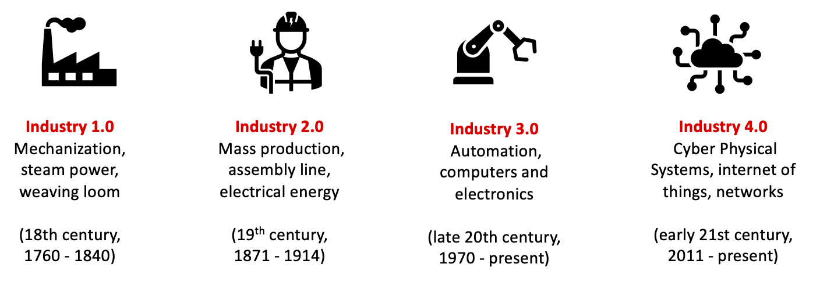
TOPIC 01 · CONTEXT
The Fourth Industrial Revolution
Industry 4.0 — cyber-physical systems, IoT, cloud computing and cognitive computing.
IoT with Raspberry Pi · TGS-2020505433
© 2026 Tertiary Infotech Academy Pte Ltd
26

Slide 27
FROM STEAM TO SENSORS
The Four Industrial Revolutions
1
2
3
4
▶
▶
▶
1.0 STEAM
Mechanisation
2.0 ELECTRICITY
Mass production
3.0 COMPUTERS
Automation
4.0 CYBER-PHYSICAL
IoT, AI and the cloud
IoT with Raspberry Pi · TGS-2020505433
© 2026 Tertiary Infotech Academy Pte Ltd
27

Slide 28
THE TECHNOLOGY LANDSCAPE
Technologies Driving Industry 4.0
Industrial IoT (IIoT)
Connected machines and sensors on the factory or plant floor.
Big data & analytics
Turning high-volume machine data into operational decisions.
1
2
Cloud computing
Storage, compute and availability without running your own servers.
Cybersecurity
Protecting devices, data and the physical processes they control.
3
4
Autonomous robots
Machines that sense their environment and act without an operator.
Digital twin
A live simulation of a physical asset, fed by its own telemetry.
5
6
IoT with Raspberry Pi · TGS-2020505433
© 2026 Tertiary Infotech Academy Pte Ltd
28

Slide 29
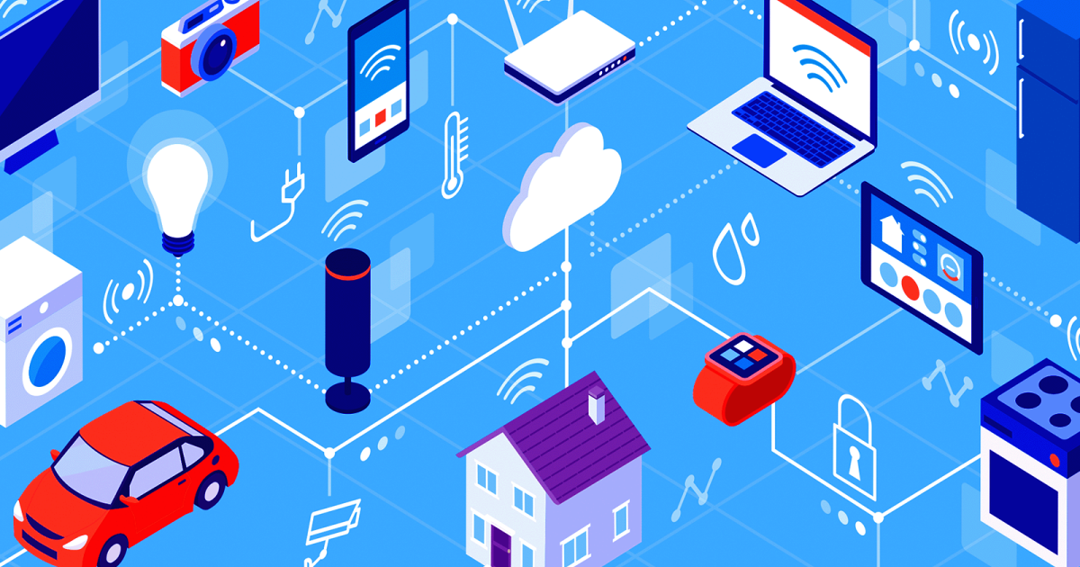
TOPIC 01 · DEFINITION
What Is the Internet of Things?
IoT connects everyday objects to the internet so they can send and receive data.
IoT with Raspberry Pi · TGS-2020505433
© 2026 Tertiary Infotech Academy Pte Ltd
29

Slide 30
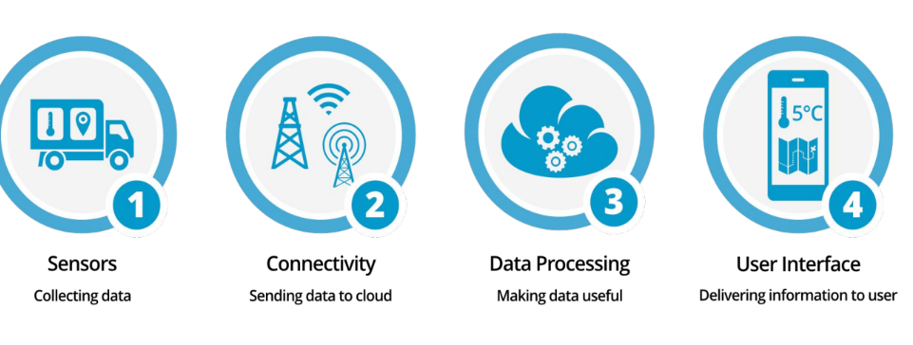
TOPIC 01 · COMPONENTS
The Components of an IoT System
A 'thing' is any object with embedded electronics that transfers data over a network.
IoT with Raspberry Pi · TGS-2020505433
© 2026 Tertiary Infotech Academy Pte Ltd
30

Slide 31
THE OPPORTUNITY
The Scale of IoT
$9T
50B+
4th
5G
Estimated IoT market value
Connected devices worldwide
Industrial revolution underway
The accelerator to mass adoption
IoT with Raspberry Pi · TGS-2020505433
© 2026 Tertiary Infotech Academy Pte Ltd
31

Slide 32
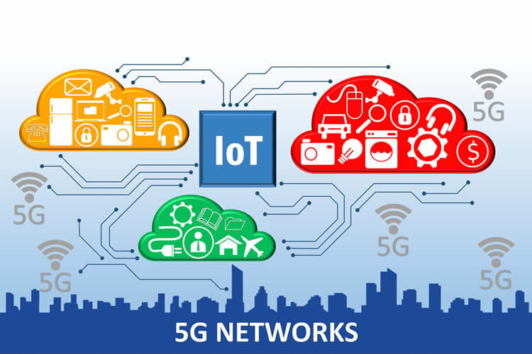
TOPIC 01 · DRIVING FORCES
Driving Forces of IoT
Low-cost sensors and long-range wireless made IoT viable; 5G is driving mass adoption.
IoT with Raspberry Pi · TGS-2020505433
© 2026 Tertiary Infotech Academy Pte Ltd
32

Slide 33
THE IoT ARCHITECTURE
How IoT Works — The Four Building Blocks
1
2
3
4
▶
▶
▶
SENSORS & DEVICES capture data from the physical world
CONNECTIVITY carries it over WiFi, cellular, LoRa or MQTT
CLOUD stores, processes and analyses the data
USER INTERFACE shows insight and sends commands back
IoT with Raspberry Pi · TGS-2020505433
© 2026 Tertiary Infotech Academy Pte Ltd
33

Slide 34
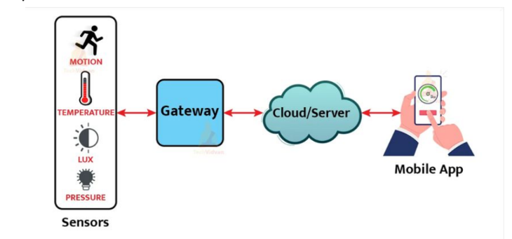
TOPIC 01 · ARCHITECTURE
How IoT Works
Sensors and devices talk to the cloud; software processes the data and acts, or shows it to a user.
IoT with Raspberry Pi · TGS-2020505433
© 2026 Tertiary Infotech Academy Pte Ltd
34

Slide 35
TOPIC 01 · SENSING THE PHYSICAL WORLD
What Is a Sensor?
Definition
A device that detects an event or change in its environment and turns it into a signal.
Temperature
Thermocouples, thermistors, RTDs and semiconductor sensors — the most measured quantity.
1
2
Humidity & pressure
Environmental monitoring for comfort, process control and weather sensing.
Proximity & motion
Detect the presence, absence or movement of an object without contact.
3
4
Gas & chemical
Air quality, CO₂ and hazardous-gas detection in cities and industrial plants.
Light & IR
Ambient light sensing, obstacle detection and remote-control technology.
5
6
IoT with Raspberry Pi · TGS-2020505433
© 2026 Tertiary Infotech Academy Pte Ltd
35

Slide 36
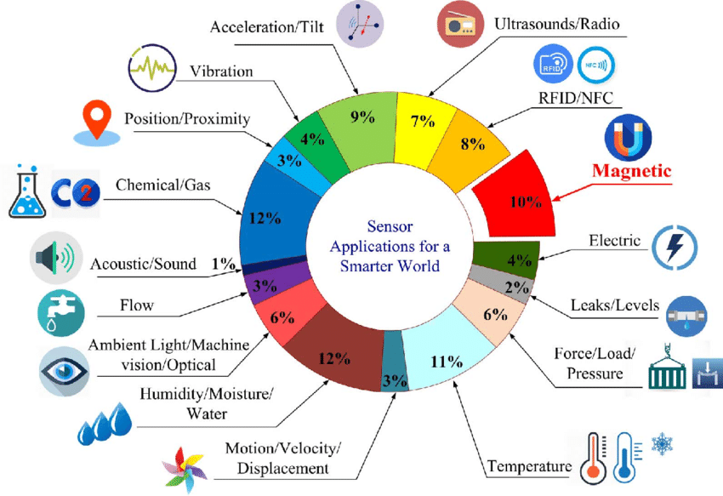
TOPIC 01 · SENSORS
Sensors for IoT
Low-cost sensors are what made large-scale IoT deployment economically viable.
IoT with Raspberry Pi · TGS-2020505433
© 2026 Tertiary Infotech Academy Pte Ltd
36

Slide 37
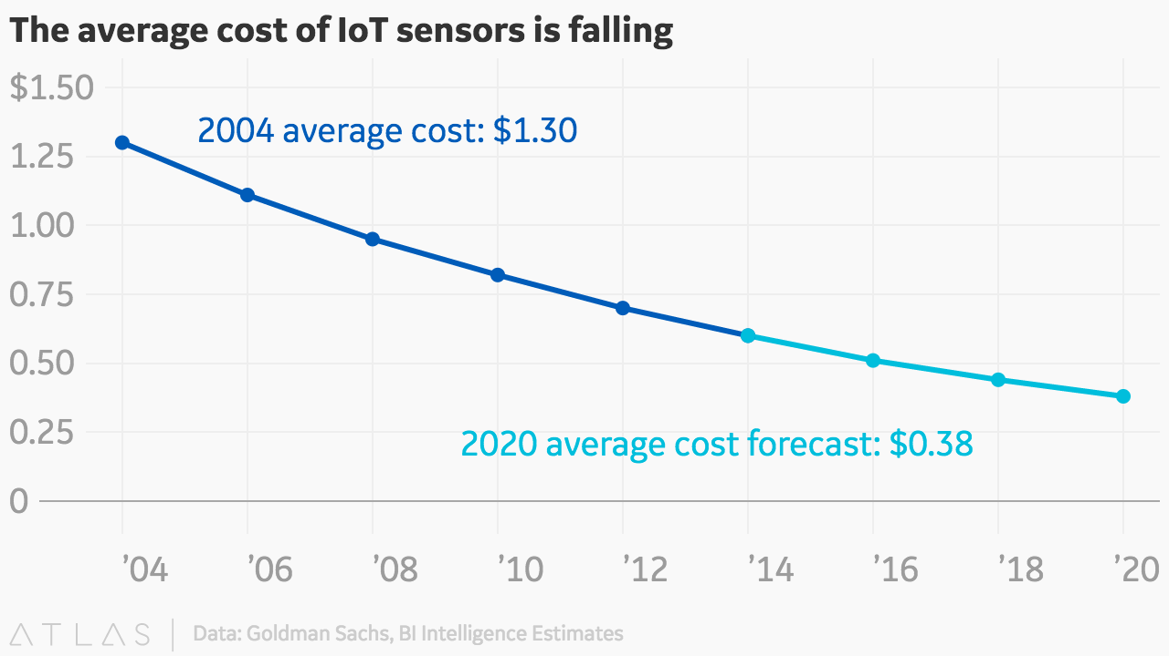
TOPIC 01 · SENSORS
More Sensors for IoT
Every physical quantity a business cares about has a low-cost sensor for it.
IoT with Raspberry Pi · TGS-2020505433
© 2026 Tertiary Infotech Academy Pte Ltd
37

Slide 38
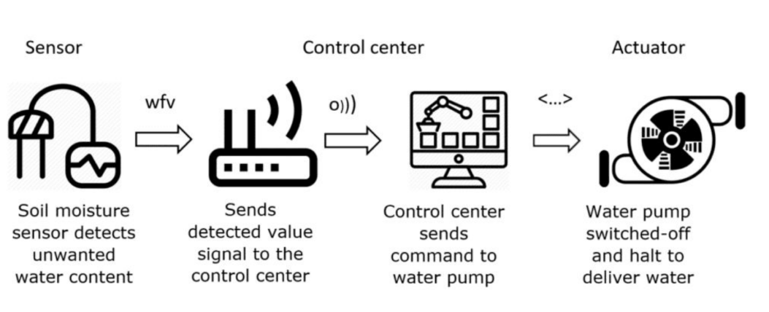
TOPIC 01 · ACTUATORS
Actuators for IoT
Actuators turn a decision in the cloud back into a physical action.
IoT with Raspberry Pi · TGS-2020505433
© 2026 Tertiary Infotech Academy Pte Ltd
38

Slide 39
THE PHYSICAL LAYER
Sensors, Actuators and Gateways
Sensors — sense
Actuators — act
Gateways — connect
• Temperature & humidity
• Motion, presence, vibration
• Light, gas, air quality
• GPS location, current
• Relays and switches
• Motors and servos
• Valves and pumps
• Alarms and displays
• Aggregate nearby devices
• Translate protocols
• Buffer when offline
• Add edge processing
IoT with Raspberry Pi · TGS-2020505433
© 2026 Tertiary Infotech Academy Pte Ltd
39

Slide 40
CONNECTIVITY CHOICES
Wireless Technologies for IoT
WiFi
High bandwidth, short range, mains power — best indoors where power is available.
Bluetooth / BLE
Very low power, very short range — wearables and personal devices.
1
2
Zigbee / Z-Wave
Low-power mesh — smart buildings and home automation.
Cellular (4G/5G)
Wide coverage with a subscription cost — vehicles, logistics and remote assets.
3
4
LoRaWAN / Sigfox
Long range, very low power, tiny payloads — agriculture, metering, city-scale sensing.
NB-IoT
Licensed low-power wide-area networking with carrier-grade reliability.
5
6
IoT with Raspberry Pi · TGS-2020505433
© 2026 Tertiary Infotech Academy Pte Ltd
40

Slide 41
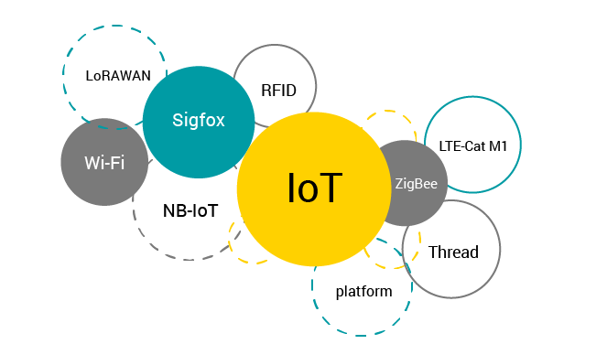
TOPIC 01 · CONNECTIVITY
Wireless Technologies for IoT
Range, power consumption, bandwidth and cost determine which technology fits a use case.
IoT with Raspberry Pi · TGS-2020505433
© 2026 Tertiary Infotech Academy Pte Ltd
41

Slide 42
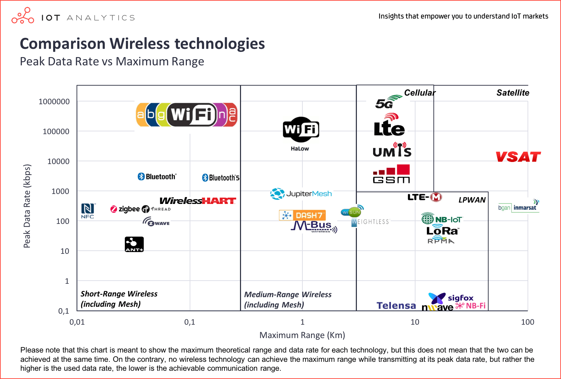
TOPIC 01 · CONNECTIVITY
Comparing Wireless Technologies
There is no single best option — every choice trades range against power, bandwidth and cost.
IoT with Raspberry Pi · TGS-2020505433
© 2026 Tertiary Infotech Academy Pte Ltd
42

Slide 43
FOUR CATEGORIES
Types of IoT
Consumer IoT
Everyday use — home appliances, voice assistants, smart lighting and wearables.
Commercial IoT
Healthcare and transport — smart pacemakers, monitoring systems, connected cars.
1
2
Industrial IoT (IIoT)
Manufacturing and energy — digital control systems and industrial big data.
Infrastructure IoT
Smart cities — infrastructure sensors and city management systems.
3
4
IoT with Raspberry Pi · TGS-2020505433
© 2026 Tertiary Infotech Academy Pte Ltd
43

Slide 44
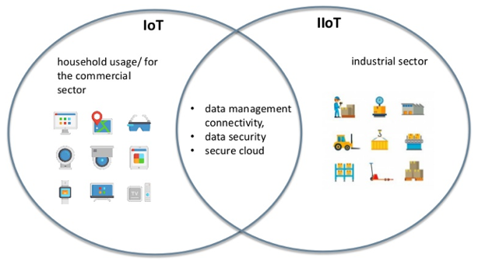
TOPIC 01 · IIoT
IoT vs Industrial IoT (IIoT)
IIoT extends IoT into industrial sectors, where reliability and safety requirements are higher.
IoT with Raspberry Pi · TGS-2020505433
© 2026 Tertiary Infotech Academy Pte Ltd
44

Slide 45
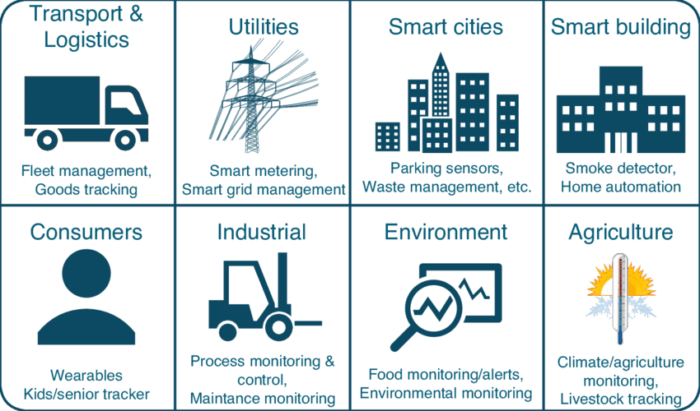
TOPIC 01 · APPLICATIONS
IoT Applications Across Industry
IoT has found its way into every conceivable field, from agriculture to aerospace.
IoT with Raspberry Pi · TGS-2020505433
© 2026 Tertiary Infotech Academy Pte Ltd
45

Slide 46
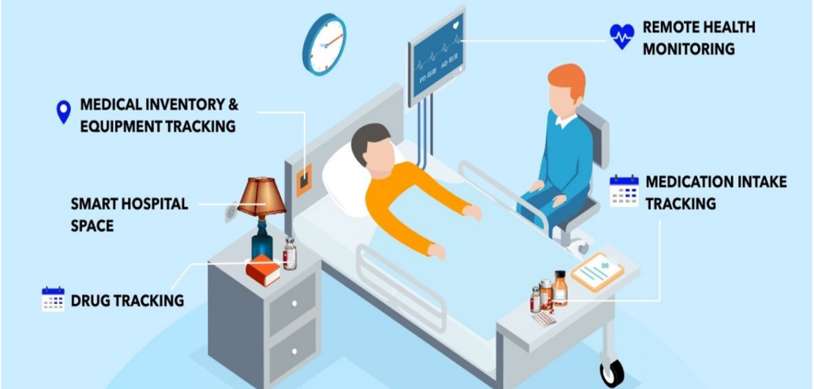
TOPIC 01 · USE CASE
Use Case — Healthcare
Asset tracking and patient monitoring: find the nearest wheelchair, watch vitals continuously.
IoT with Raspberry Pi · TGS-2020505433
© 2026 Tertiary Infotech Academy Pte Ltd
46

Slide 47
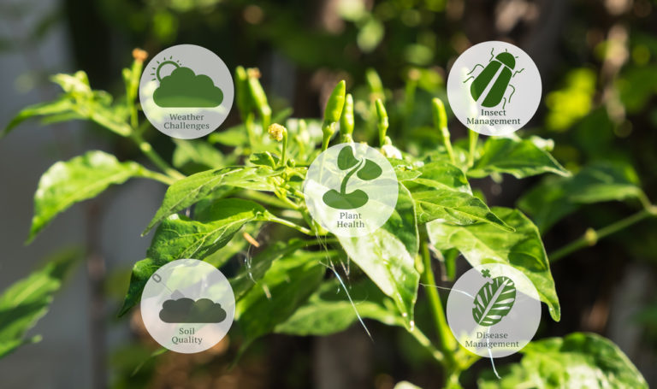
TOPIC 01 · USE CASE
Use Case — Agriculture
Soil, weather and crop sensing drive precision irrigation and fertiliser decisions.
IoT with Raspberry Pi · TGS-2020505433
© 2026 Tertiary Infotech Academy Pte Ltd
47

Slide 48
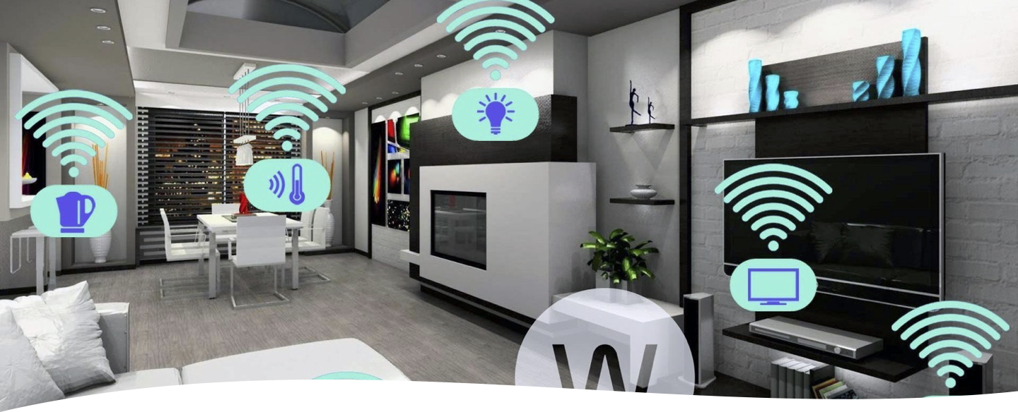
TOPIC 01 · USE CASE
Use Case — Smart Home
Smart outlets, thermostats, locks and leak detectors improve efficiency and safety.
IoT with Raspberry Pi · TGS-2020505433
© 2026 Tertiary Infotech Academy Pte Ltd
48

Slide 49
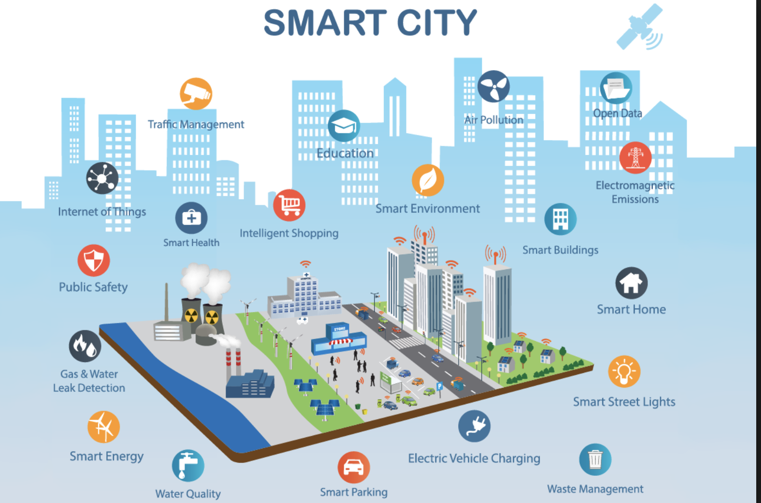
TOPIC 01 · USE CASE
Use Case — Smart City
Air quality, smart lighting, infrastructure monitoring and parking management.
IoT with Raspberry Pi · TGS-2020505433
© 2026 Tertiary Infotech Academy Pte Ltd
49

Slide 50
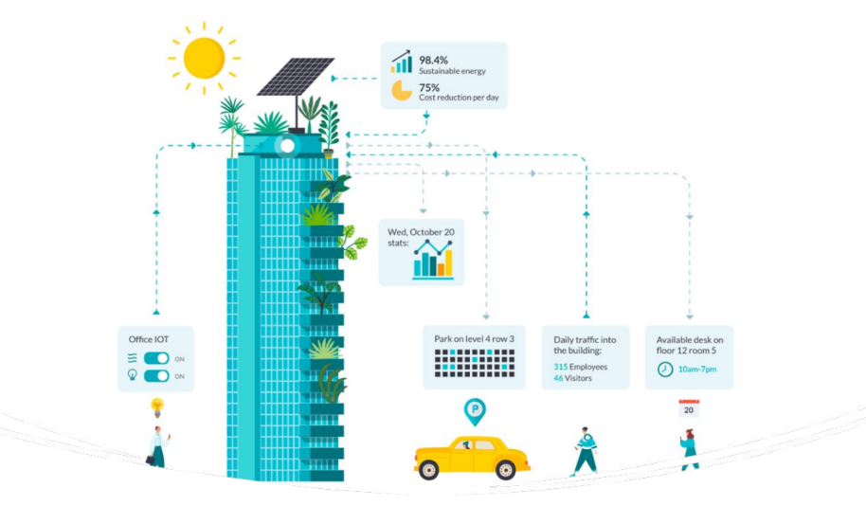
TOPIC 01 · USE CASE
Use Case — Smart Building
Occupancy, energy and equipment sensing cut utility cost and enable predictive maintenance.
IoT with Raspberry Pi · TGS-2020505433
© 2026 Tertiary Infotech Academy Pte Ltd
50

Slide 51
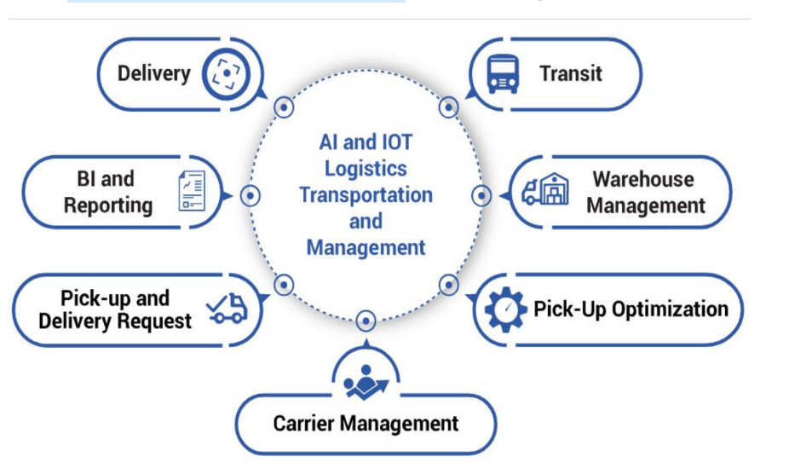
TOPIC 01 · USE CASE
Use Case — Logistics
Track-and-trace with temperature control — critical for food, flowers and pharmaceuticals.
IoT with Raspberry Pi · TGS-2020505433
© 2026 Tertiary Infotech Academy Pte Ltd
51

Slide 52
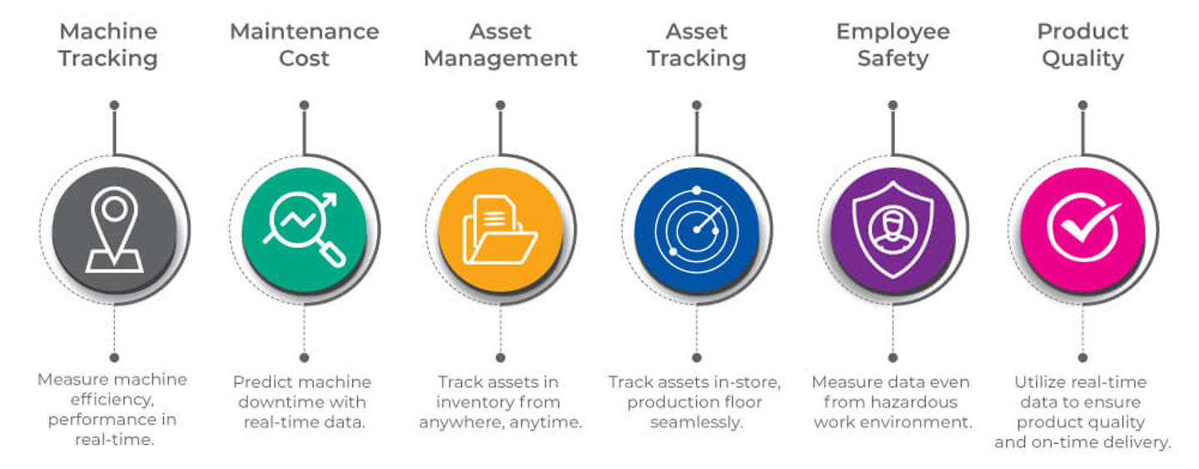
TOPIC 01 · USE CASE
Use Case — Manufacturing
Production-line monitoring enables proactive maintenance before equipment fails.
IoT with Raspberry Pi · TGS-2020505433
© 2026 Tertiary Infotech Academy Pte Ltd
52

Slide 53
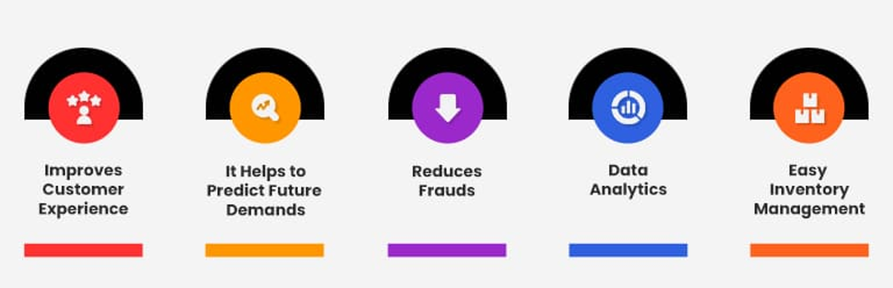
TOPIC 01 · USE CASE
Use Case — Retail
Smart shelves and beacons manage inventory and personalise the customer experience.
IoT with Raspberry Pi · TGS-2020505433
© 2026 Tertiary Infotech Academy Pte Ltd
53

Slide 54
TOPIC 01 · ACTIVITY
Discussion — Analyse an IoT Use Case
DISCUSSION · 20 MIN
In pairs, pick one of the IoT use cases covered (healthcare, agriculture, connected vehicles, smart home, smart city, smart building, logistics, manufacturing or retail) and analyse how the data collected leads to a recommended control action.
1
2
3
4
What is physically being sensed, how often, and by what kind of sensor?
Which wireless technology suits that deployment — and why does range or power decide it?
What control action does the data recommend, and who or what carries it out?
What would the organisation lose if that measurement did not exist?
YOUR OUTPUT A short analysis linking the sensed data to a specific recommended control action.
IoT with Raspberry Pi · TGS-2020505433
© 2026 Tertiary Infotech Academy Pte Ltd
54

Slide 55
TOPIC RECAP
Recap — Overview of Internet of Things (IoT)
• IoT connects physical objects to the internet so they can collect and exchange data.
• Every IoT system has four blocks: sensors/devices, connectivity, cloud processing and a user interface.
• Sensors turn a physical phenomenon into a signal; actuators turn a decision back into physical action.
• Wireless choice trades range against power, bandwidth and cost — there is no single best option.
IoT with Raspberry Pi · TGS-2020505433
© 2026 Tertiary Infotech Academy Pte Ltd
55

Slide 56
Lunch Break
1 hour · Digital attendance (PM) on your return

Slide 57
02
TOPIC 02
Collect and Post Environmental Data to Cloud
Cloud platforms · Raspberry Pi · Sensors · Device tokens · HTTP REST & MQTT uplink
IoT with Raspberry Pi · TGS-2020505433
© 2026 Tertiary Infotech Academy Pte Ltd
57

Slide 58
LO2 · A2, K2, K3 · Day 1 PM
Key Concepts — Collect and Post Environmental Data to Cloud
Cloud computing for IoT
The cloud gives constrained devices the storage, compute and availability they lack.
IoTFlow
Our platform: projects, devices, tokens, dashboards, alerts and automations in one place.
1
2
Raspberry Pi as gateway
A low-cost Linux computer with GPIO, WiFi and Python — it reads sensors and speaks to the cloud.
Reading environmental data
Temperature, humidity and pressure from a Sense HAT, DHT11/DHT22 or a simulated source.
3
4
Device tokens
A token authenticates every message a device sends — and is why credential management matters.
HTTP REST & MQTT uplink
POST JSON to a REST endpoint, or publish over MQTT for lightweight real-time streaming.
5
6
IoT with Raspberry Pi · TGS-2020505433
© 2026 Tertiary Infotech Academy Pte Ltd
58

Slide 59
THE CLOUD LAYER
Cloud Computing for IoT
Why the cloud
Constrained devices lack the storage, compute and availability the data needs.
Always available
The platform keeps receiving data whether or not your laptop is switched on.
1
2
Scales with the fleet
One device or a thousand — the same endpoint and the same code.
Data persistence
History is retained so trends and performance can be analysed later.
3
4
Accessible anywhere
A browser or a phone shows the same live data from any location.
Integrations
Webhooks and APIs push events into the systems the business already uses.
5
6
IoT with Raspberry Pi · TGS-2020505433
© 2026 Tertiary Infotech Academy Pte Ltd
59

Slide 60
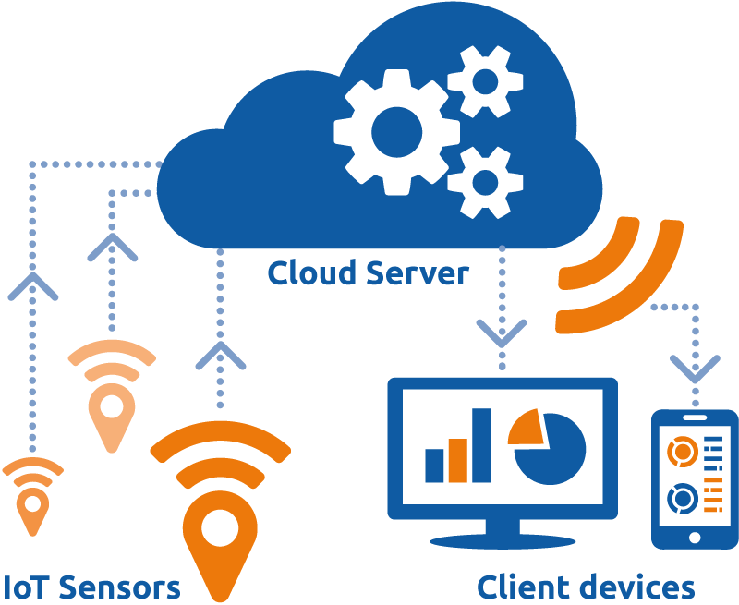
TOPIC 02 · THE CLOUD LAYER
Cloud Computing for IoT
The cloud gives constrained devices the storage, compute and availability they lack.
IoT with Raspberry Pi · TGS-2020505433
© 2026 Tertiary Infotech Academy Pte Ltd
60

Slide 61
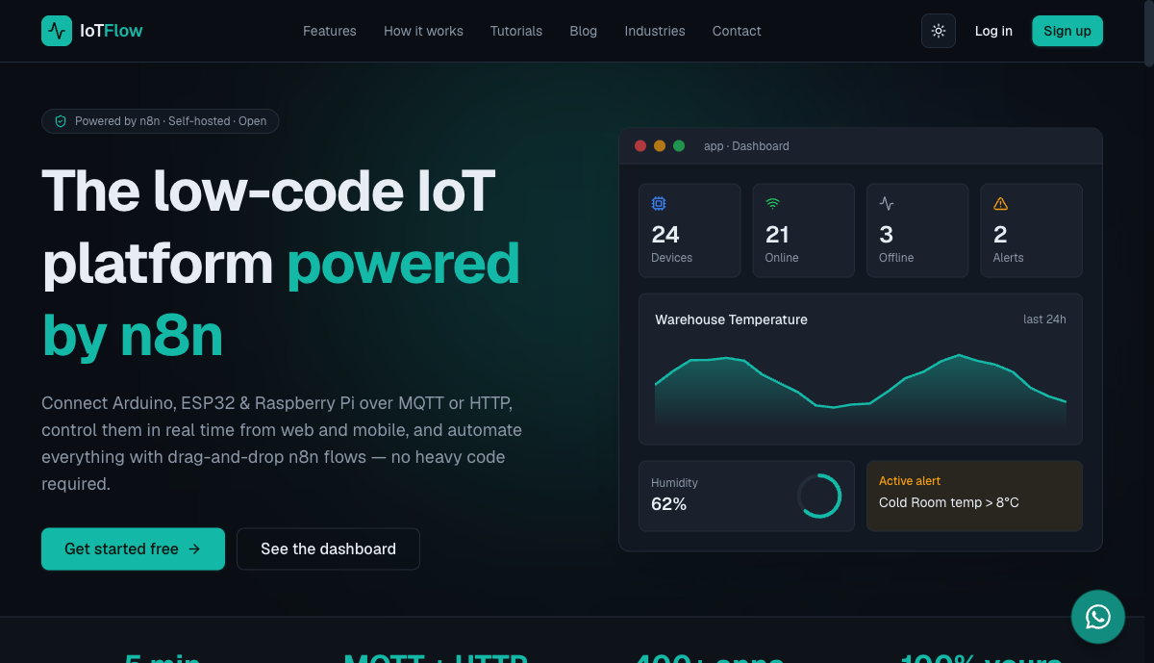
TOPIC 02 · OUR PLATFORM
IoTFlow — https://iot.tertiaryinfotech.com
The platform you will use for every lab in this course.
IoT with Raspberry Pi · TGS-2020505433
© 2026 Tertiary Infotech Academy Pte Ltd
61

Slide 62
https://iot.tertiaryinfotech.com
IoTFlow — Our IoT Platform
Projects
A self-contained workspace with its own devices, dashboard, alerts, map and automations.
Devices & tokens
Register a device in a guided wizard; a device token authenticates every message it sends.
1
2
HTTP & MQTT
POST JSON to a REST endpoint, or publish/subscribe over MQTT for real-time two-way traffic.
Dashboards
Number cards, gauges, charts, LED indicators and maps that refresh automatically.
3
4
Alerts & automations
Threshold and offline rules that fire a webhook into an n8n workflow.
Clients
Official Python client (pip install iotflow) and an Arduino library for ESP32/ESP8266.
5
6
IoT with Raspberry Pi · TGS-2020505433
© 2026 Tertiary Infotech Academy Pte Ltd
62

Slide 63
THE DEVICE LAYER
The Raspberry Pi as an IoT Gateway
A full Linux computer
Low cost and credit-card sized, running Raspberry Pi OS with Python built in.
GPIO pins
Connect sensors and actuators directly to the board — no extra hardware needed.
1
2
Built-in WiFi
Reaches the cloud without a separate network module.
Python ecosystem
sense_hat, gpiozero, adafruit-dht and the iotflow client are a pip install away.
3
4
Runs unattended
systemd restarts your sensor script automatically after a power cut.
Remote access
SSH or VNC lets you work on the Pi headless, from your laptop.
5
6
IoT with Raspberry Pi · TGS-2020505433
© 2026 Tertiary Infotech Academy Pte Ltd
63

Slide 64
THREE WAYS TO GET A READING
Reading Environmental Data
Sense HAT
DHT11 / DHT22
Simulated data
• Temperature, humidity, pressure
• Motion and orientation
• 8×8 LED matrix and joystick
• One import: sense_hat
• Temperature and humidity
• Connects to a single GPIO pin
• Very low cost
• adafruit_dht library
• No hardware required
• Random or replayed values
• Useful for testing the uplink
• Identical platform behaviour
IoT with Raspberry Pi · TGS-2020505433
© 2026 Tertiary Infotech Academy Pte Ltd
64

Slide 65
FROM SENSOR TO ACTION AND BACK
The IoT Data Round Trip
1
2
3
4
5
▶
▶
▶
▶
DEVICE reads a sensor value
UPLINK posts it over HTTP or MQTT
CLOUD stores, charts and evaluates rules
DECISION — a person or an automation acts
DOWNLINK sends a command back to the device
IoT with Raspberry Pi · TGS-2020505433
© 2026 Tertiary Infotech Academy Pte Ltd
65

Slide 66
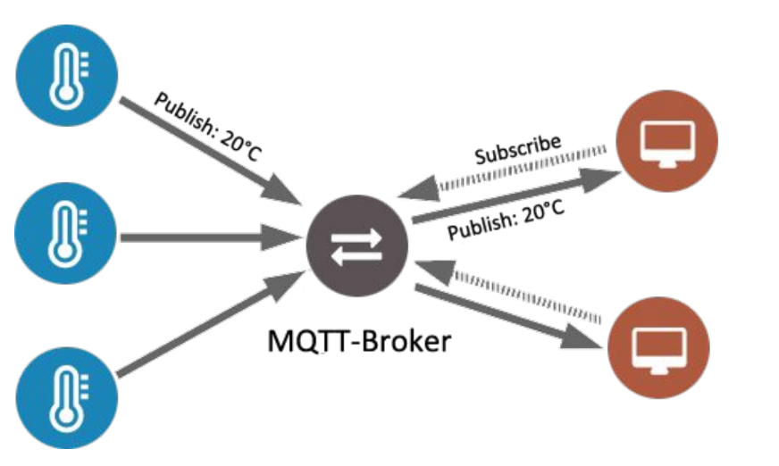
TOPIC 02 · PROTOCOLS
How MQTT Works
Publish/subscribe: devices publish to a topic and the broker delivers to every subscriber.
IoT with Raspberry Pi · TGS-2020505433
© 2026 Tertiary Infotech Academy Pte Ltd
66

Slide 67
CHOOSING YOUR UPLINK PROTOCOL
HTTP REST vs MQTT
Simple
Real-time
• HTTP REST
– Request/response
– Simplest to start with
– POST JSON to an endpoint
– Works from cURL or any language
– Higher overhead per message
• MQTT
– Publish/subscribe via a broker
– Lightweight and low bandwidth
– Persistent connection
– Best for real-time two-way control
– Ideal for many devices
IoT with Raspberry Pi · TGS-2020505433
© 2026 Tertiary Infotech Academy Pte Ltd
67

Slide 68
K2 · AUTHENTICATING THE DEVICE
Device Tokens and Security
What a token is
A secret string that authenticates every message the device sends.
Shown once
Copy it when the device is created — the platform will not display it again.
1
2
Anyone holding it can post
A leaked token means someone else can publish as your device.
Keep it out of code
Store it in an environment variable, never in a Git repository.
3
4
Use TLS endpoints
Encrypt the data in transit so the token cannot be read off the wire.
Rotate if exposed
Regenerate the token immediately if you suspect it has leaked.
5
6
IoT with Raspberry Pi · TGS-2020505433
© 2026 Tertiary Infotech Academy Pte Ltd
68

Slide 69
TOPIC 02 · PRACTICAL
Hands-On Practical — Labs 1 and 2
Running on IoTFlow (https://iot.tertiaryinfotech.com). Step-by-step instructions are in your Learner Guide — follow along there.
IoT with Raspberry Pi · TGS-2020505433
© 2026 Tertiary Infotech Academy Pte Ltd
69

Slide 70
TOPIC 02 · HANDS-ON
Register Your Raspberry Pi on IoTFlow
LAB 1
Identify an area for an IoT solution and connect the asset to the cloud (A2, K2).
Turn your Raspberry Pi into a managed IoT device. You sign in to IoTFlow, create a project workspace for your monitoring scenario, register the Pi through the Add Device wizard, choose how it will talk to the cloud (HTTP or MQTT), and capture the device token that authenticates every message it sends.
YOU'LL BUILD
WHY THE BUSINESS CARES
A registered Raspberry Pi device in your own IoTFlow project, with its device token saved
This is the first step of any IoT deployment: an asset that was previously invisible now has an identity, an owner and a data stream that can be measured, monitored and managed.
TOOLS IoTFlow projects · Add Device wizard · Device tokens · HTTP & MQTT
IoT with Raspberry Pi · TGS-2020505433
© 2026 Tertiary Infotech Academy Pte Ltd
70

Slide 71
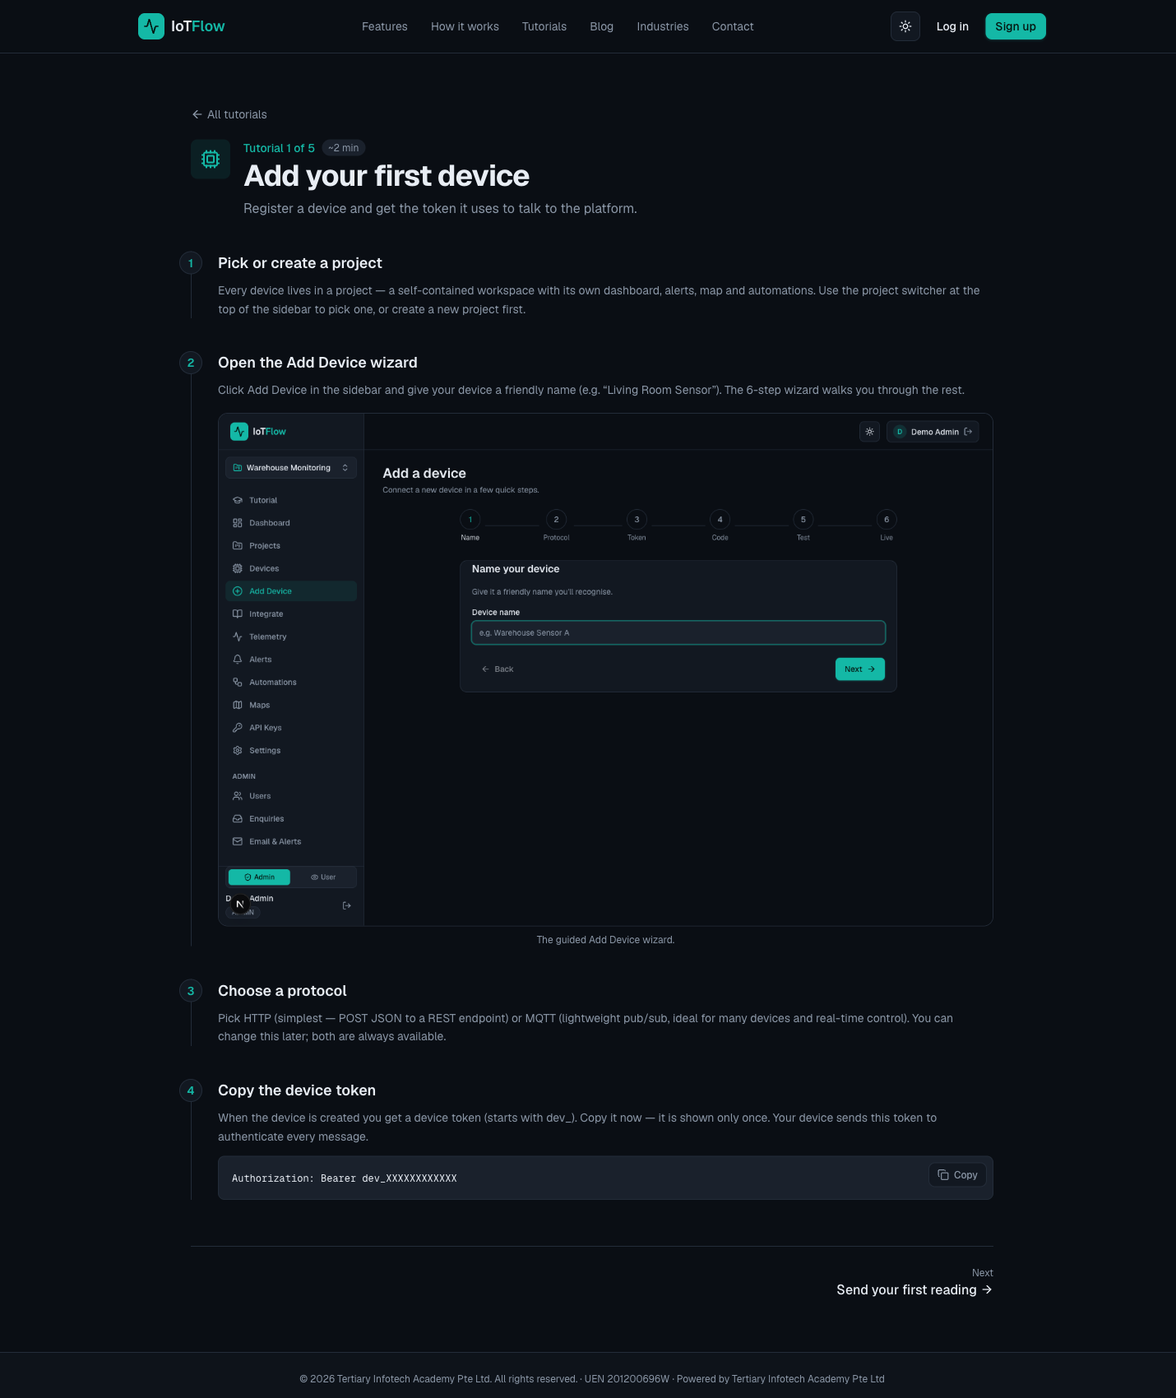
TOPIC 02 · WHAT YOU'LL SEE
Lab 1 — Register Your Raspberry Pi on IoTFlow
IoTFlow — A registered Raspberry Pi device in your own IoTFlow project, with its device token saved
IoT with Raspberry Pi · TGS-2020505433
© 2026 Tertiary Infotech Academy Pte Ltd
71

Slide 72
TOPIC 02 · HANDS-ON
Collect Environmental Data and Post It to the Cloud
LAB 2
Collect environment data with the Raspberry Pi and post it to cloud computing (A2, K2, K3).
Read temperature and humidity on the Raspberry Pi and stream the readings to IoTFlow — first with a single cURL call, then with the official Python client over HTTP, then continuously over MQTT. This is the uplink every IoT solution depends on: without a reliable data stream there is nothing to analyse.
YOU'LL BUILD
WHY THE BUSINESS CARES
Live temperature and humidity telemetry streaming from the Raspberry Pi into IoTFlow
Each reading is an operational fact with a timestamp. Once the stream exists, the organisation can answer questions it previously could not — how often, how long, how bad, and at what cost.
TOOLS Sense HAT / DHT22 · Telemetry REST API · Python client (pip install iotflow) · MQTT broker
IoT with Raspberry Pi · TGS-2020505433
© 2026 Tertiary Infotech Academy Pte Ltd
72

Slide 73
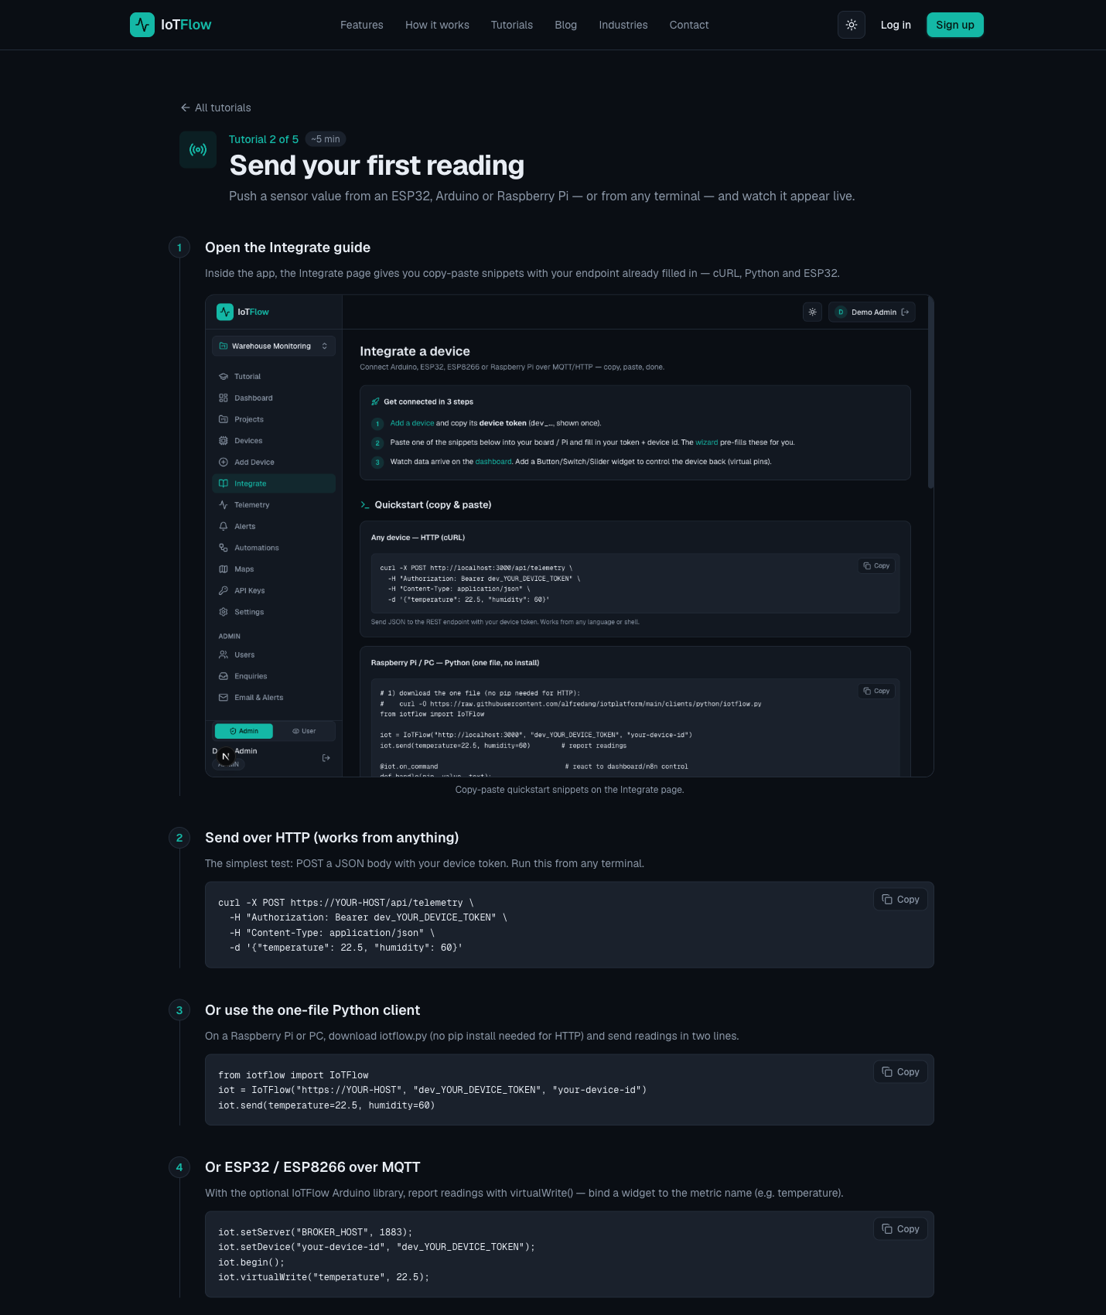
TOPIC 02 · WHAT YOU'LL SEE
Lab 2 — Collect Environmental Data and Post It to the Cloud
IoTFlow — Live temperature and humidity telemetry streaming from the Raspberry Pi into IoTFlow
IoT with Raspberry Pi · TGS-2020505433
© 2026 Tertiary Infotech Academy Pte Ltd
73

Slide 74
TOPIC RECAP
Recap — Collect and Post Environmental Data to Cloud
• The cloud gives a constrained device the storage, availability and reach it does not have on its own.
• The Raspberry Pi reads a sensor over GPIO and posts the reading to the cloud over HTTP or MQTT.
• A device token authenticates every message — treat it like a password.
• Once the uplink is reliable, the business finally has data it can act on.
IoT with Raspberry Pi · TGS-2020505433
© 2026 Tertiary Infotech Academy Pte Ltd
74

Slide 75
SEE YOU AT 9:30AM
End of Day 1
Tomorrow: turn the data you are now collecting into a dashboard, an alert, and an automatic control action.
IoT with Raspberry Pi · TGS-2020505433
© 2026 Tertiary Infotech Academy Pte Ltd
75

Slide 76
2
DAY 2
Analytics, Visualisation and Control — From Data to Action
Topic 3: IoT Data Analytics and Visualization · Topic 4: Monitor Data to Trigger Control from Cloud
IoT with Raspberry Pi · TGS-2020505433
© 2026 Tertiary Infotech Academy Pte Ltd
76

Slide 77
03
TOPIC 03
IoT Data Analytics and Visualization
Dashboards · Number cards, gauges & charts · Maps · Alert rules · Analysing trends
IoT with Raspberry Pi · TGS-2020505433
© 2026 Tertiary Infotech Academy Pte Ltd
77

Slide 78
WHY VISUALISE
Raw readings are not insight.
A number in a database changes nothing. A dashboard that makes a problem obvious — and an alert that arrives in time — is what changes the outcome.
IoT with Raspberry Pi · TGS-2020505433
© 2026 Tertiary Infotech Academy Pte Ltd
78

Slide 79
LO3 · A3, K4, K5 · Day 2 AM
Key Concepts — IoT Data Analytics and Visualization
Why visualise
A dashboard turns a stream of raw readings into an operational picture a manager can act on.
Display widgets
Number cards, gauges, line and bar charts, LED indicators and maps, refreshed automatically.
1
2
Analysing the data
Compare current readings against history to spot trends, drift and abnormal behaviour.
Alert rules
Threshold and device-offline rules fire the moment a reading crosses a business-meaningful limit.
3
4
Recording performance
Telemetry history is the evidence base for measuring whether the solution actually works.
From data to decision
Analytics only pays off when a reading changes what somebody — or something — does next.
5
6
IoT with Raspberry Pi · TGS-2020505433
© 2026 Tertiary Infotech Academy Pte Ltd
79

Slide 80
DISPLAY WIDGETS
Choosing the Right Widget
Number card
One current value at a glance — the reading somebody asks for most often.
Gauge
A value inside its safe operating range — instantly shows 'how close to the limit'.
1
2
Line chart
History over time — the only way to see trends, drift and daily cycles.
Bar chart
Comparing totals across periods or across devices.
3
4
LED indicator
A binary state: on/off, open/closed, healthy/faulty.
Map
Where the device is — essential for vehicles, logistics and field assets.
5
6
IoT with Raspberry Pi · TGS-2020505433
© 2026 Tertiary Infotech Academy Pte Ltd
80

Slide 81
A3 · THE ANALYTICS PIPELINE
From Reading to Decision
1
2
3
4
5
▶
▶
▶
▶
COLLECT telemetry from the device
VISUALISE it on a dashboard
ANALYSE the history for trends and drift
DETECT when a threshold is crossed
DECIDE and record the action taken
IoT with Raspberry Pi · TGS-2020505433
© 2026 Tertiary Infotech Academy Pte Ltd
81

Slide 82
K5 · ADVANCED PROCESS CONTROL
Analysing IoT Data
Current vs normal
Compare the live reading against the established operating range.
Trends over time
A slow drift upward is often more important than a single high reading.
1
2
Peaks and troughs
The extremes reveal whether the process ever leaves its safe envelope.
Noise vs event
One odd sample is noise; a sustained change is a real event worth acting on.
3
4
Correlation
Temperature rising as humidity falls tells a story neither metric tells alone.
Recording performance
The telemetry history is the evidence that the solution actually works.
5
6
IoT with Raspberry Pi · TGS-2020505433
© 2026 Tertiary Infotech Academy Pte Ltd
82

Slide 83
DETECTING WHAT MATTERS
Alert Rules That Work
Threshold rules
Fire when a metric crosses a limit: temperature > 30, humidity < 40.
Device-offline rules
Fire when a device stops reporting — silent failure is the biggest risk.
1
2
Set a meaningful limit
Choose the value at which a person would genuinely need to act.
Avoid alert fatigue
Too many alerts and the real one gets ignored — tune the threshold.
3
4
Active and resolved
Track the alert lifecycle so response time can be measured.
Trigger automation
An alert can call a webhook and start a workflow with no human involved.
5
6
IoT with Raspberry Pi · TGS-2020505433
© 2026 Tertiary Infotech Academy Pte Ltd
83

Slide 84
TOPIC 03 · PRACTICAL
Hands-On Practical — Lab 3
Running on IoTFlow (https://iot.tertiaryinfotech.com). Step-by-step instructions are in your Learner Guide — follow along there.
IoT with Raspberry Pi · TGS-2020505433
© 2026 Tertiary Infotech Academy Pte Ltd
84

Slide 85
TOPIC 03 · HANDS-ON
Analyse and Visualise Your IoT Data on the Cloud
LAB 3
Use the platform's tools to analyse IoT data and record performance (A3, K4, K5).
Build a live dashboard from the readings your Raspberry Pi is streaming — number cards, gauges, line charts, LED indicators and a map — then interrogate the history to spot trends and set a threshold alert at the point where somebody would actually need to act.
YOU'LL BUILD
WHY THE BUSINESS CARES
A live monitoring dashboard for your Raspberry Pi, plus a working threshold alert rule
This is the screen the supervisor actually looks at. A dashboard makes performance visible, and an alert makes a problem timely instead of discovered too late.
TOOLS Display widgets · Number cards · Gauges · Line charts · Maps · Alert rules · Telemetry history
IoT with Raspberry Pi · TGS-2020505433
© 2026 Tertiary Infotech Academy Pte Ltd
85

Slide 86
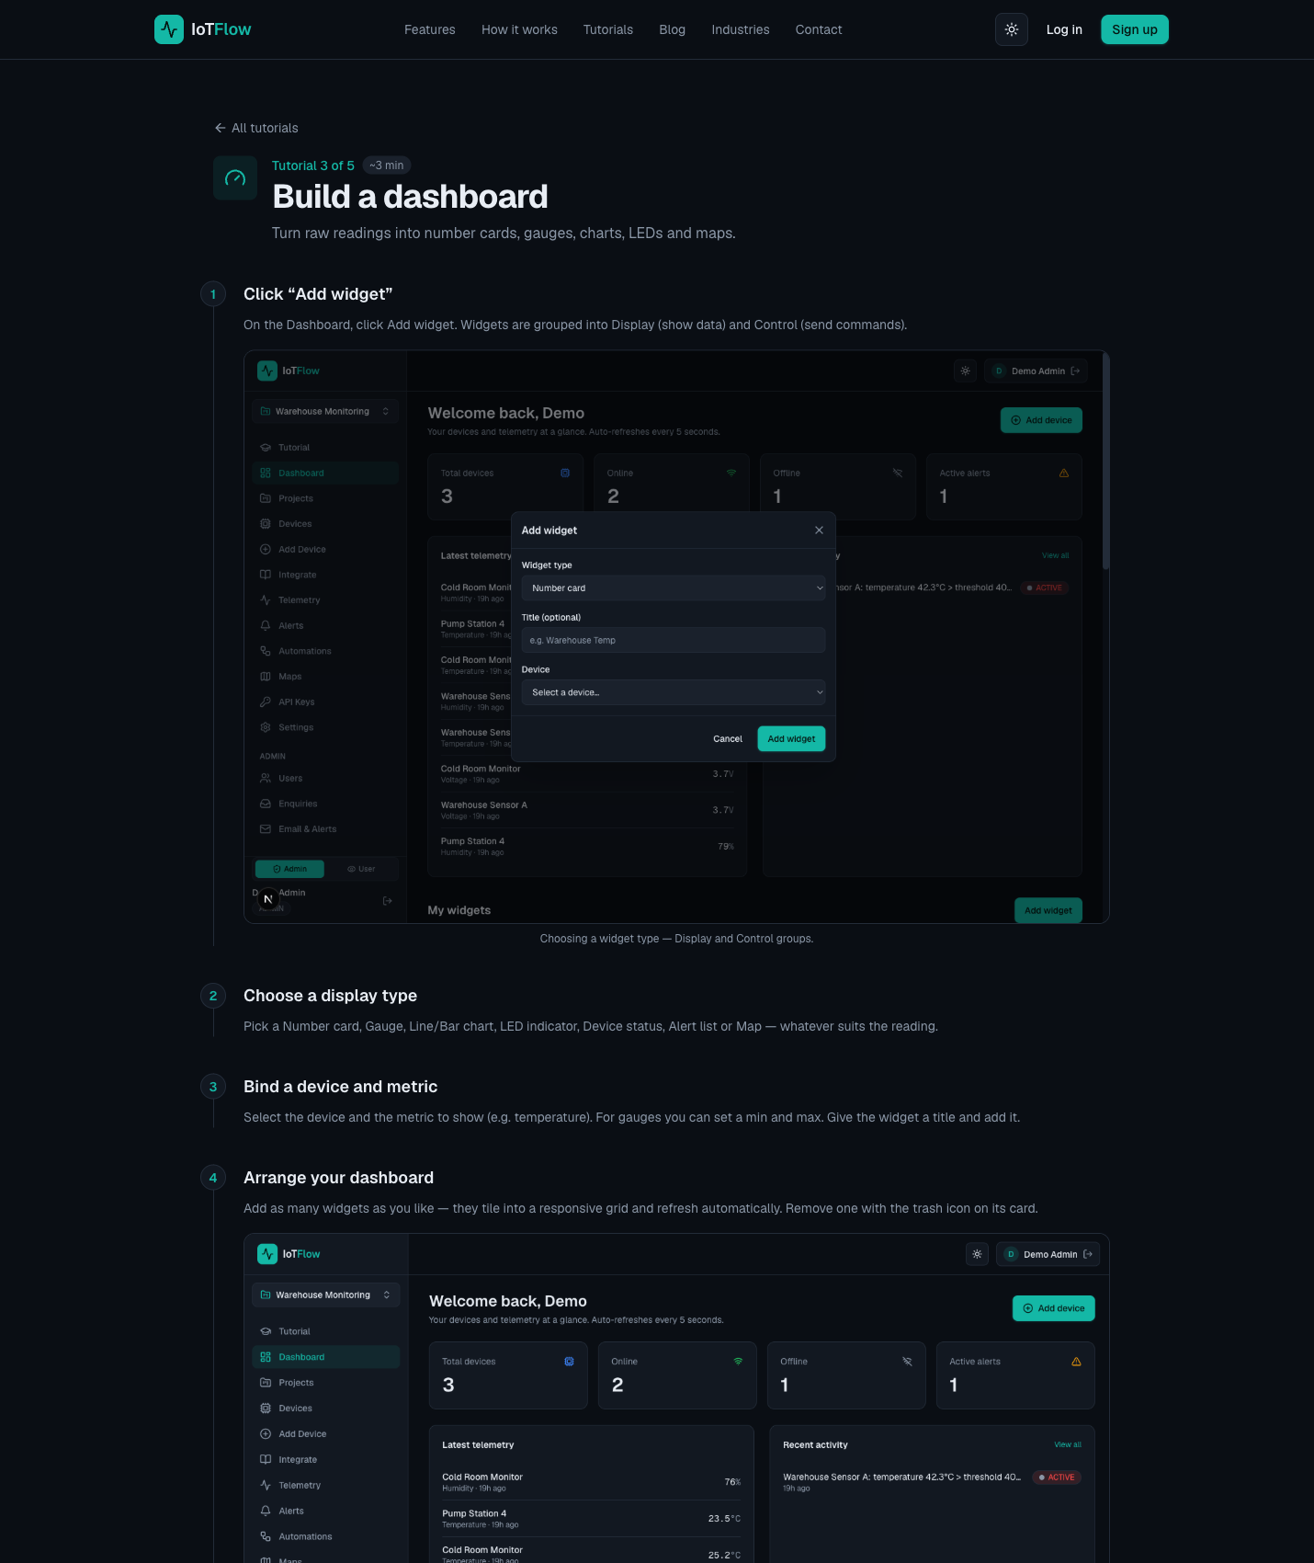
TOPIC 03 · WHAT YOU'LL SEE
Lab 3 — Analyse and Visualise Your IoT Data on the Cloud
IoTFlow — A live monitoring dashboard for your Raspberry Pi, plus a working threshold alert rule
IoT with Raspberry Pi · TGS-2020505433
© 2026 Tertiary Infotech Academy Pte Ltd
86

Slide 87
TOPIC 03 · ACTIVITY
Discussion — Design Your Monitoring Dashboard
DISCUSSION · 20 MIN
Working from the data your Raspberry Pi is now streaming, decide what a supervisor actually needs to see on one screen, and which threshold would justify interrupting somebody.
1
2
3
4
Which three widgets earn their place on the screen, and what does each one answer?
What is the normal operating range, and at what value does it become a problem?
How would you tell a genuine fault apart from a single noisy reading?
What performance record would you need to prove the solution is working?
YOUR OUTPUT A dashboard layout plus one justified alert threshold with its rationale.
IoT with Raspberry Pi · TGS-2020505433
© 2026 Tertiary Infotech Academy Pte Ltd
87

Slide 88
TOPIC RECAP
Recap — IoT Data Analytics and Visualization
• A dashboard turns a stream of readings into an operational picture somebody can act on.
• Pick the widget that answers the question: number for now, gauge for range, chart for trend.
• Analyse history, not just the latest value — trends and drift matter more than one sample.
• An alert rule set at a business-meaningful threshold turns monitoring into timely action.
IoT with Raspberry Pi · TGS-2020505433
© 2026 Tertiary Infotech Academy Pte Ltd
88

Slide 89
Lunch Break
1 hour · Digital attendance (PM) on your return

Slide 90
04
TOPIC 04
Monitor Data to Trigger Control from Cloud
Downlink control · Virtual pins · Automations & n8n · Monitoring effectiveness · IoT security
IoT with Raspberry Pi · TGS-2020505433
© 2026 Tertiary Infotech Academy Pte Ltd
90

Slide 91
LO4 · A4, K6, K7 · Day 2 PM
Key Concepts — Monitor Data to Trigger Control from Cloud
Reading data back
Query the current state of every metric and virtual pin over the REST API or MQTT.
Downlink control
Virtual pins carry commands from the dashboard back to the device to switch a relay or set a value.
1
2
Closing the loop
Monitoring tells you what happened; control lets the system act without anyone driving to site.
Automation with n8n
Alerts fire a webhook into a low-code workflow that notifies, logs, and can ask AI to recommend.
3
4
Monitoring effectiveness
Track uptime, alert response and the metric you set out to improve — then tune the rules.
IoT security
Constrained, unattended devices with physical consequences — protect tokens, transport and firmware.
5
6
IoT with Raspberry Pi · TGS-2020505433
© 2026 Tertiary Infotech Academy Pte Ltd
91

Slide 92
TWO DIRECTIONS, TWO PURPOSES
Uplink vs Downlink
Monitoring
Control
• Uplink — telemetry
– Device → cloud
– Sensor readings and status
– HTTP POST /api/telemetry
– or MQTT publish
– This is your monitoring data
• Downlink — commands
– Cloud → device
– Switch a relay, set a value
– MQTT topic devices/<id>/down
– or HTTP state polling
– This is your automation
IoT with Raspberry Pi · TGS-2020505433
© 2026 Tertiary Infotech Academy Pte Ltd
92

Slide 93
K3 · EQUIPMENT AUTOMATION
Control Widgets and Virtual Pins
Virtual pin
A named channel (V1, relay, pump) carrying a command from dashboard to device.
Switch
A toggle for a persistent on/off state — a relay, a fan, a pump.
1
2
Button
A momentary action — reset, trigger, open for two seconds.
Slider
A value within a range — motor speed, brightness, a setpoint.
3
4
Terminal
Free-text commands for diagnostics and advanced control.
@on_command
The handler on the Pi that receives the value and drives the GPIO pin.
5
6
IoT with Raspberry Pi · TGS-2020505433
© 2026 Tertiary Infotech Academy Pte Ltd
93

Slide 94
A4 · THE FULL LOOP
Closing the Monitor-and-Control Loop
1
2
3
4
5
▶
▶
▶
▶
SENSE — the Pi reads the temperature
REPORT — telemetry arrives in the cloud
DETECT — the alert rule crosses its threshold
AUTOMATE — n8n notifies, logs and decides
ACT — a downlink command switches the fan on
IoT with Raspberry Pi · TGS-2020505433
© 2026 Tertiary Infotech Academy Pte Ltd
94

Slide 95
LOW-CODE WORKFLOWS
Automation with n8n
Webhook trigger
IoTFlow calls an n8n webhook when your chosen event fires.
Notify
Email, Telegram or WhatsApp so the right person hears about it immediately.
1
2
Record
Append the event to Google Sheets or a database to build the performance history.
Analyse with AI
An AI node summarises recent readings and recommends an action in plain language.
3
4
Control
An HTTP Request node sends a downlink command straight back to the device.
No code
The whole workflow is drag-and-drop — no server and no deployment.
5
6
IoT with Raspberry Pi · TGS-2020505433
© 2026 Tertiary Infotech Academy Pte Ltd
95

Slide 96
TOPIC 04 · PRACTICAL
Hands-On Practical — Lab 4
Running on IoTFlow (https://iot.tertiaryinfotech.com). Step-by-step instructions are in your Learner Guide — follow along there.
IoT with Raspberry Pi · TGS-2020505433
© 2026 Tertiary Infotech Academy Pte Ltd
96

Slide 97
TOPIC 04 · HANDS-ON
Monitor Data and Trigger Control on the Raspberry Pi
LAB 4
Monitor IoT data and trigger a control action on the device from the cloud (A4, K6, K7).
Read device state back out of the cloud over the REST API and MQTT, then add Control widgets (switch, slider) bound to virtual pins and drive an LED or relay on the Raspberry Pi from the dashboard. Reading data is monitoring; sending a command back is automation — and that is where the labour saving appears.
YOU'LL BUILD
WHY THE BUSINESS CARES
A dashboard switch and slider that control an LED/relay on the Raspberry Pi in real time
Monitoring tells you what happened. Control lets the system act without a person driving out to site — usually the single largest line in an IoT cost-benefit case.
TOOLS REST API (GET /api/device/state) · MQTT subscribe · Control widgets · Virtual pins · @on_command · GPIO
IoT with Raspberry Pi · TGS-2020505433
© 2026 Tertiary Infotech Academy Pte Ltd
97

Slide 98
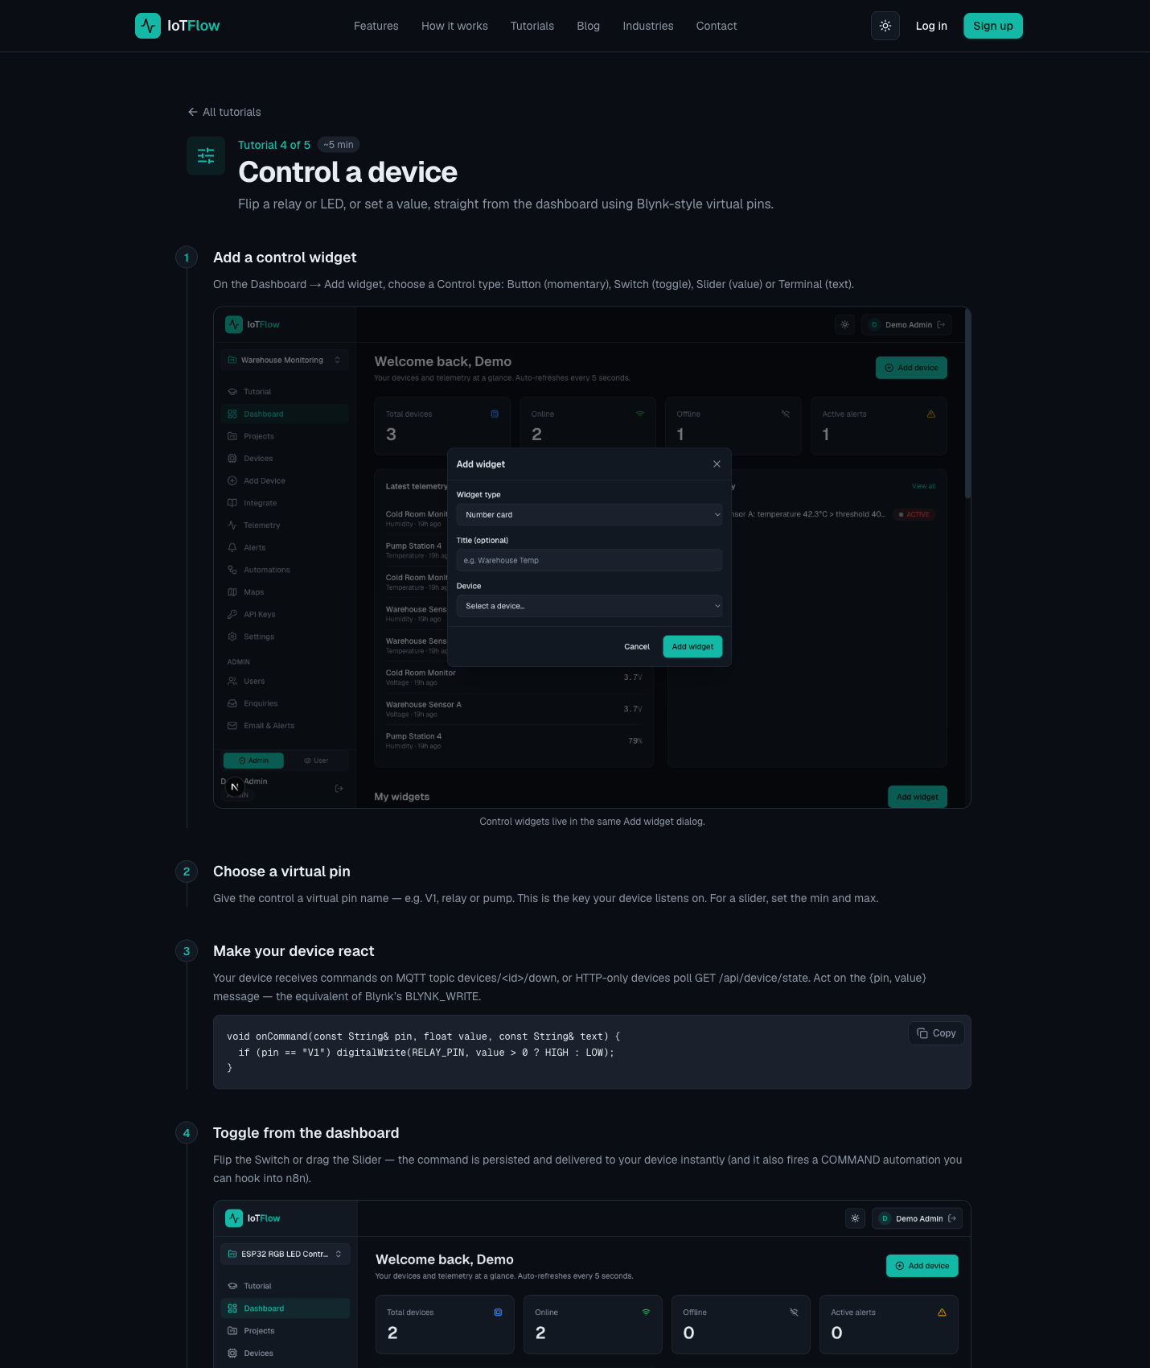
TOPIC 04 · WHAT YOU'LL SEE
Lab 4 — Monitor Data and Trigger Control on the Raspberry Pi
IoTFlow — A dashboard switch and slider that control an LED/relay on the Raspberry Pi in real time
IoT with Raspberry Pi · TGS-2020505433
© 2026 Tertiary Infotech Academy Pte Ltd
98

Slide 99
A4 · IS IT WORKING?
Monitoring the Effectiveness of an IoT Solution
Device uptime
What percentage of the time is the device actually reporting?
Data completeness
Are readings arriving at the expected interval, with no silent gaps?
1
2
Alert response time
How long from the threshold being crossed to the action being taken?
False-positive rate
How many alerts turned out not to need any action at all?
3
4
The business metric
Did downtime, energy, spoilage or labour actually improve?
Tune and repeat
Adjust thresholds and sampling rates based on what the record shows.
5
6
IoT with Raspberry Pi · TGS-2020505433
© 2026 Tertiary Infotech Academy Pte Ltd
99

Slide 100
K6 · RISK FACTORS
IoT Security — Why It Is Different
Constrained devices
Unattended & long-lived
Physical consequences
• Microcontrollers, not servers
• Often battery powered
• May not support TLS/SSL
• Run for years without supervision
• Patching is inconvenient
• Rogue devices go unnoticed
• IT breach leaks data
• IoT breach can cause harm
• Safety-critical systems at risk
IoT with Raspberry Pi · TGS-2020505433
© 2026 Tertiary Infotech Academy Pte Ltd
100

Slide 101
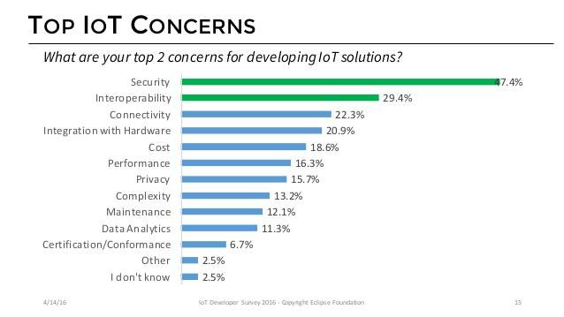
TOPIC 04 · SECURITY
IoT Security Is a Top Concern
Security and data privacy are consistently the biggest barriers to IoT adoption.
IoT with Raspberry Pi · TGS-2020505433
© 2026 Tertiary Infotech Academy Pte Ltd
101

Slide 102
CASE STUDY · WHY DEVICE SECURITY MATTERS
The Mirai botnet, 12 October 2016.
Default credentials on cameras and routers were harvested into a botnet whose DDoS attack took much of the US east coast offline — an unsecured device is everyone's problem.
IoT with Raspberry Pi · TGS-2020505433
© 2026 Tertiary Infotech Academy Pte Ltd
102

Slide 103
K6 · SECURITY AND PRIVACY APPLICATIONS
Securing Your IoT Solution
Change default credentials
The single most common cause of IoT compromise — Mirai proved it.
Protect the device token
Environment variables, never source control; rotate it if exposed.
1
2
Encrypt in transit
Use TLS endpoints so readings and tokens cannot be read off the wire.
Keep firmware updated
Unpatched, unattended devices are the easiest target on any network.
3
4
Segment the network
Keep IoT devices off the network carrying business-critical systems.
Least privilege
A device should be able to do its job and nothing more.
5
6
IoT with Raspberry Pi · TGS-2020505433
© 2026 Tertiary Infotech Academy Pte Ltd
103

Slide 104
K7 · STANDARDS THAT MATTER
IoT Guidelines and Communication Standards
MQTT
OASIS-standard lightweight publish/subscribe messaging — the IoT default.
HTTP / REST
Universally supported request-response, easiest to integrate and debug.
1
2
CoAP
A compact request-response protocol designed for very constrained devices.
IEEE 802.15.4
The physical/MAC layer beneath Zigbee and other low-rate wireless networks.
3
4
LoRaWAN
LoRa Alliance specification for long-range, low-power wide-area networking.
IMDA & PDPA
Singapore's IoT cyber-security guide and personal-data obligations.
5
6
IoT with Raspberry Pi · TGS-2020505433
© 2026 Tertiary Infotech Academy Pte Ltd
104

Slide 105
TOPIC 04 · ACTIVITY
Discussion — Monitor Effectiveness and Manage Risk
DISCUSSION · 20 MIN
Take the IoT solution you have built across the labs and plan how you would monitor its effectiveness in production — and how you would secure it.
1
2
3
4
Which metrics tell you the solution is working — uptime, response time, or the business outcome?
How would you know a device had silently stopped reporting?
Where are the credentials in your solution, and what happens if one leaks?
Which standard or guideline would you cite when asked how the data is protected?
YOUR OUTPUT A monitoring and security plan: the effectiveness metrics, the offline strategy, and the top three risks.
IoT with Raspberry Pi · TGS-2020505433
© 2026 Tertiary Infotech Academy Pte Ltd
105

Slide 106
TOPIC RECAP
Recap — Monitor Data to Trigger Control from Cloud
• Reading data back and sending commands forward turns monitoring into automation.
• Virtual pins carry the command from the dashboard to a handler that drives the GPIO pin.
• Alerts plus n8n notify, record, analyse with AI and can act with no human in the loop.
• Measure effectiveness — uptime, response time and the business metric — and secure every layer.
IoT with Raspberry Pi · TGS-2020505433
© 2026 Tertiary Infotech Academy Pte Ltd
106

Slide 107
WRAP-UP
Course Summary & Next Steps
IoT with Raspberry Pi · TGS-2020505433
© 2026 Tertiary Infotech Academy Pte Ltd
107

Slide 108
LEARNING OUTCOMES
What You Achieved
1
LO1 · Analysed IoT technologies
Sensors, actuators, wireless technologies and use cases across nine industries.
2
LO2 · Collected and posted data
Registered a Raspberry Pi and streamed live sensor readings over HTTP and MQTT.
3
LO3 · Analysed and visualised
Built a live dashboard, analysed telemetry history and set a working alert rule.
4
LO4 · Monitored and controlled
Drove hardware from the cloud and automated the response end to end.
IoT with Raspberry Pi · TGS-2020505433
© 2026 Tertiary Infotech Academy Pte Ltd
108

Slide 109
AFTER TODAY
Your Next Steps
Keep your IoTFlow project
Your devices, dashboard and automations stay available after the course.
Deploy your Pi for real
Pick one thing worth measuring and let it run unattended for a week.
1
2
Revisit the Learner Guide
Every lab's step-by-step instructions are there for you to repeat.
Explore the tutorials
More platform walkthroughs at https://iot.tertiaryinfotech.com/tutorials
3
4
IoT with Raspberry Pi · TGS-2020505433
© 2026 Tertiary Infotech Academy Pte Ltd
109

Slide 110
CONTINUE YOUR LEARNING
Recommended Courses
• WSQ - Internet of Things (IoT) Fundamental for Beginners
• WSQ - Business Innovation with Internet of Things (IoT)
• WSQ - Practical Electronics Design with Arduino Microcontroller
• WSQ - Hands-On Guide to IoT Development with Microcontrollers
• Browse the full catalogue at www.tertiarycourses.com.sg
IoT with Raspberry Pi · TGS-2020505433
© 2026 Tertiary Infotech Academy Pte Ltd
110

Slide 111
SUMMARY
Summary & Q&A
• IoT connects physical assets so an organisation can measure what used to be invisible.
• The Raspberry Pi reads the physical world; the cloud stores, analyses and acts on it.
• Dashboards make performance visible, alerts make problems timely, automation closes the loop.
• Any questions before the assessment?
IoT with Raspberry Pi · TGS-2020505433
© 2026 Tertiary Infotech Academy Pte Ltd
111

Slide 112
ASSESSMENT · 120 MINUTES TOTAL
Final Assessment
WA (Q&A) — 60 min
Practical Performance — 60 min
Before you begin
• Short-answer questions
• Assesses knowledge K1–K7
• Open book
• Build a working IoT solution
• Assesses abilities A1–A4
• Open book, done individually
• Take the Assessment digital attendance
• Complete the TRAQOM survey
• Slides + Learner Guide allowed
• Submit as directed by your assessor
IoT with Raspberry Pi · TGS-2020505433
© 2026 Tertiary Infotech Academy Pte Ltd
112

Slide 113
ON ASSESSMENT DAY
Assessment Flow
1
2
3
4
5
6
▶
▶
▶
▶
▶
TRAQOM survey — scan the QR code on the LMS
Assessment digital attendance — scan the SSG QR
Sit the WA (Q&A) — 60 min, open book
Complete the Practical Performance — 60 min
Submit your answers on the LMS
Sign the Assessment Summary Record
IoT with Raspberry Pi · TGS-2020505433
© 2026 Tertiary Infotech Academy Pte Ltd
113

Slide 114
TRAQOM · SSG DIGITAL ATTENDANCE
Digital Attendance & TRAQOM Survey (Mandatory)
Assessment attendance
Take the Assessment digital attendance before you begin — scan the SSG QR code.
Cert & TRAQOM survey
Complete the mandatory survey at https://lms-tms.tertiaryinfotech.com/
1
2
Your certificate
Your certificate is issued through the LMS once you are assessed Competent.
75% minimum
At least 75% attendance is required to be eligible for assessment and funding.
3
4
IoT with Raspberry Pi · TGS-2020505433
© 2026 Tertiary Infotech Academy Pte Ltd
114

Slide 115
WE'RE HERE TO HELP — DURING AND AFTER THE CLASS
Support
Email
enquiry@tertiaryinfotech.com
Telephone
+65 6100 0613
1
2
Website
www.tertiarycourses.com.sg
LMS / TMS portal
https://lms-tms.tertiaryinfotech.com
3
4
IoT with Raspberry Pi · TGS-2020505433
© 2026 Tertiary Infotech Academy Pte Ltd
115

Slide 116
SEE YOU AT THE NEXT COURSE
Thank You!
You can now build, analyse and control a complete IoT solution with a Raspberry Pi and the cloud.
IoT with Raspberry Pi · TGS-2020505433
© 2026 Tertiary Infotech Academy Pte Ltd
116

